Slide 1

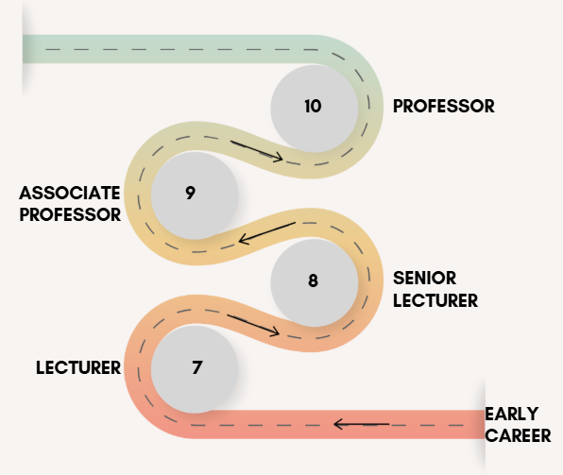
Promotion Review
Overview and Consultation

Slide 2
Purpose of the Review
The University is committed to supporting the career progression of academic staff
The promotions process is being reviewed to:
Improve fairness, transparency, and consistency
Introduce a more inclusive and evidence-based framework
Ensure a fair, consistent, and systematic framework for all academic staff
Apply a promotions framework which will support career progression and can align with performance reviews
Enable the University to develop a structured pathway for professional growth and evaluation

Slide 3
Why Now?
Current process has limitations in fairness and clarity. This has been raised by staff and UCU over a number of years
Current process disproportionately impacts on the career progression of female academics
Need for consistent criteria and consistent career progression routes for all academic staff
Aim to establish a promotions framework which includes a robust and challenging set of criteria and responsibilities, which also broadly reflects the expectations and standards of the sector
Notes:
Link to career development, training and performance objective and targets

Slide 4
Consultation Overview?
Two Phases of Consultation:
    Phase One (March–May 2025): Focus on role profiles and promotion criteria
    Phase Two (May–July 2025): Focus on process implementation (e.g., panels, feedback, training)
* Timeline is dependent on feedback, level of changes required and the finalising the consultation period
Open to feedback from all academic staff
Encourage staff to reflect on three key questions:
    Is the role profile a full and accurate reflection of the expected tasks and responsibilities? If not, please specify which duties and why. (Please note roles are based on the Academic Library Profiles and in line with sector expectations)
    Are any aspects of the role profiles or criteria demonstrably inaccurate?
    Is there any significant promotion criteria that has been overlooked?
Notes:
Too broad to do all at once

Slide 5
Phase 1 - Key Dates and Milestones
Dates | Activity
10 March – 30 April 2025 | Consultation period with faculty executive board and online feedback.
30 April – 9 May 2025 | Analysis and reporting of feedback.
End of May 2025 | Final agreement from UEB and UCU.
All staff feedback must be received by Wednesday 23 April 2025

Slide 6
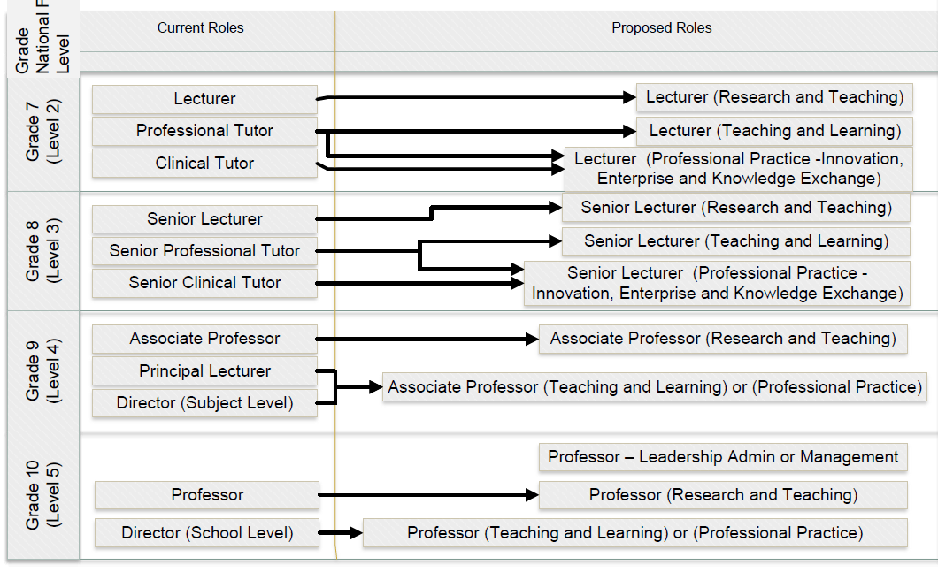
Updated Role Profiles and Titles
Consolidated job titles across all academic grades
Grade 7: Lecturer
Grade 8: Senior Lecturer
Grade 9: Associate Professor
Grade 10: Professor
*Job titles will not include brackets
Notes:
A mapping exercise will be completed with your Line Manager and Head of School to determine the most appropriate underlying contract.

Slide 7
Updated Role Profiles
Split into
    Generic - Academic duties applicable to all
    and
    Underlying contract – Dependent on the contract type
Provides a broad range of duties and responsibilities – expectations of the level
Role Profile – it is not as prescriptive as a job description given the broad range and flexibility expected across academic roles and as agreed by UCU. (Generic role profiles for academic-related staff using the HERA schemes as the underpinning job evaluation scheme)
Individuals expected to carry out a range of duties and responsibilities. Should be allocated in a fair and balanced manner, in line with SAM
Matches expectations outlined within the contracts for each grade
It is not anticipated that all of the activities will be covered by one individual, it is expected that over time all individuals will make a balanced and overall contribution
Notes:
Has been done in line with National Library of Academic Role Profiles and current roles in mind
Should not be any new or unexpected duties
Aim is to achieve a balance across the role on a range of duties

Slide 8
Role Profiles Mapping
Professional Tutors and Senior Professional Tutors will remain as is until promotion review is complete
Mapping will be done with individual staff, Head of School and Faculty Executive Dean
Teaching and Research very similar, no major changes to this route
Teaching and Learning aligns with current Professional Tutor / Senior Professional Tutor / Teaching and Scholarship contracts and expectations
Professional Practice, Innovation, Enterprise and Knowledge Exchange – aligns with sector and captures colleagues who fall under this definition
Mapping with be aligned with School and Faculty breakdown, balanced approach based on organisational need and strategy goals
Notes:
SAM - Professional Practice, Innovation, Enterprise and Knowledge Exchange

Slide 9
New Promotion Routes
Promotion will align with underlying contract types:
    Teaching and Learning
    Teaching and Research
    Professional Practice – Innovation, Enterprise, and Knowledge Exchange
New framework designed to enable all academics to apply for promotion under one cohesive framework

Slide 10
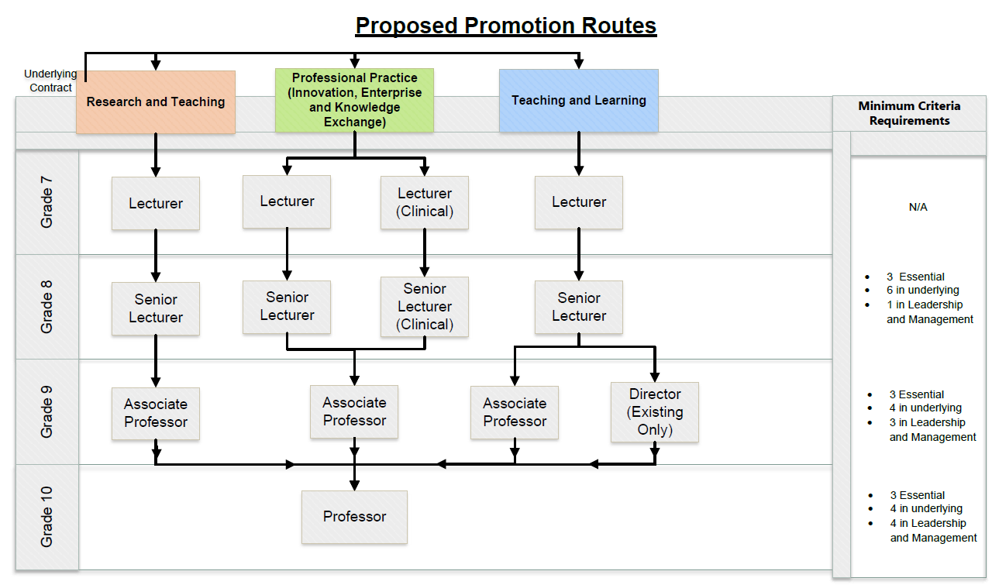
New Promotion Routes

Slide 11
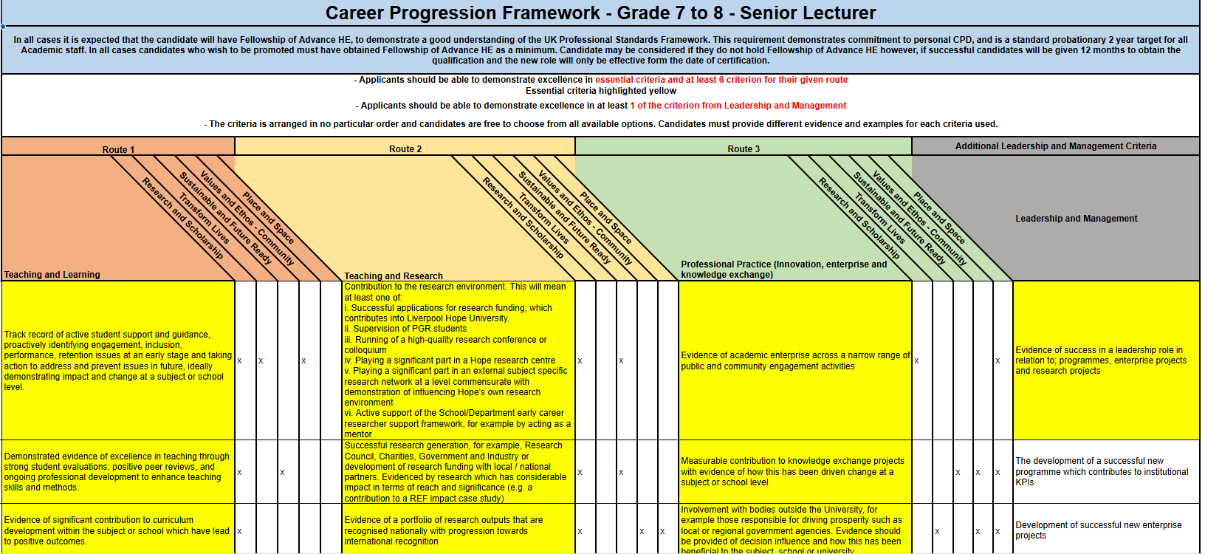
Promotion Framework
Indicative example – full document can be found at https://www.hope.ac.uk/gateway/staff/peopleservices/promotion-academiccareerprogression/

Slide 12
Promotion Criteria
Incremental expectation as the individual moves up the grade
Increasing expectation for leadership, with varying levels of impact / contribution, moving up through subject, school and faculty level
Essential criteria must be met
Staff can decide which other criteria to address within their given route
Aim to provide a wide range of criteria, to capture the wide range of tasks and areas that academics contribute to
Balance sector expectations with Hope’s institutional design and structure
Should enable colleagues to career plan and inform performance review targets and objectives
Notes:
For example we have broadened out the leadership responsibility and examples to reflect the wide range of leadership activities that some colleagues undertake

Slide 13
Feedback and Participation
We will gather some initial thoughts and comments from yourselves following this presentation
In providing feedback we encourage staff to reflect on three key questions:
Is the role profile a full and accurate reflection of the expected tasks and responsibilities? If not, please specify which duties and why. (Please note roles are based on the Academic Library Profiles and in line with sector expectations)
Are any aspects of the role profiles or criteria demonstrably inaccurate?
Is there any significant promotion criteria that has been overlooked?
Email to promotions@hope.ac.uk by 23 April 2025.

Slide 14
Overall Benefits of the Review?
Transparent and evidence-based promotion framework
Enhanced support for professional development
Broader opportunities for career progression
Ensures fairness and consistency across all faculties and schools

Slide 15
Next Steps?
Staff are encouraged to engage in the consultation process
Feedback will help shape the final promotion framework
We are also consulting with UCU throughout phase 1 and 2
Phase 2 will commence in late May / early June following completion of phase 1. Process will follow a similar format as phase 1
Revised framework to launch in Autumn 2025
Please note the above dates are dependent on feedback, level of changes required and the finalising of the consultation period

Slide 16
Q&A?
We now invite questions and initial comments and thoughts from staff.
Recap: In providing feedback we encourage staff to reflect on three key questions:
Is the role profile a full and accurate reflection of the expected tasks and responsibilities? If not, please specify which duties and why. (Please note roles are based on the Academic Library Profiles and in line with sector expectations)
Are any aspects of the role profiles or criteria demonstrably inaccurate?
Is there any significant promotion criteria that has been overlooked?
Email to promotions@hope.ac.uk by 23 April 2025.

